Slide 1
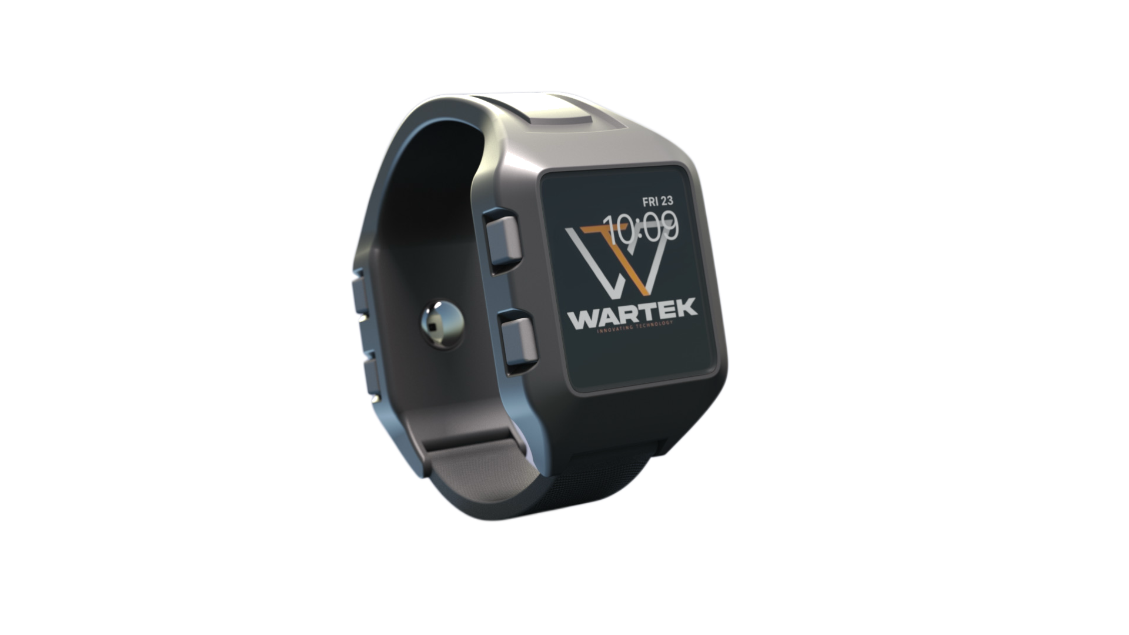
WARTEK
● U.S. PATENT GRANTED — NO. 12,625,472
WARTEK
The world's first dual-display tactical watch.
INVESTOR BRIEFING
Jaylan Mobley · Founder & CEO
jaylan@wartek.co · wartek.co

Slide 2
WARTEK
— A NEW CATEGORY —
Introducing the
world's first dual-display
tactical watch.
“The prior art does not teach nor suggest”
— USPTO Examiner, U.S. Patent No. 12,625,472 · Granted May 2026
02 / 19

Slide 3
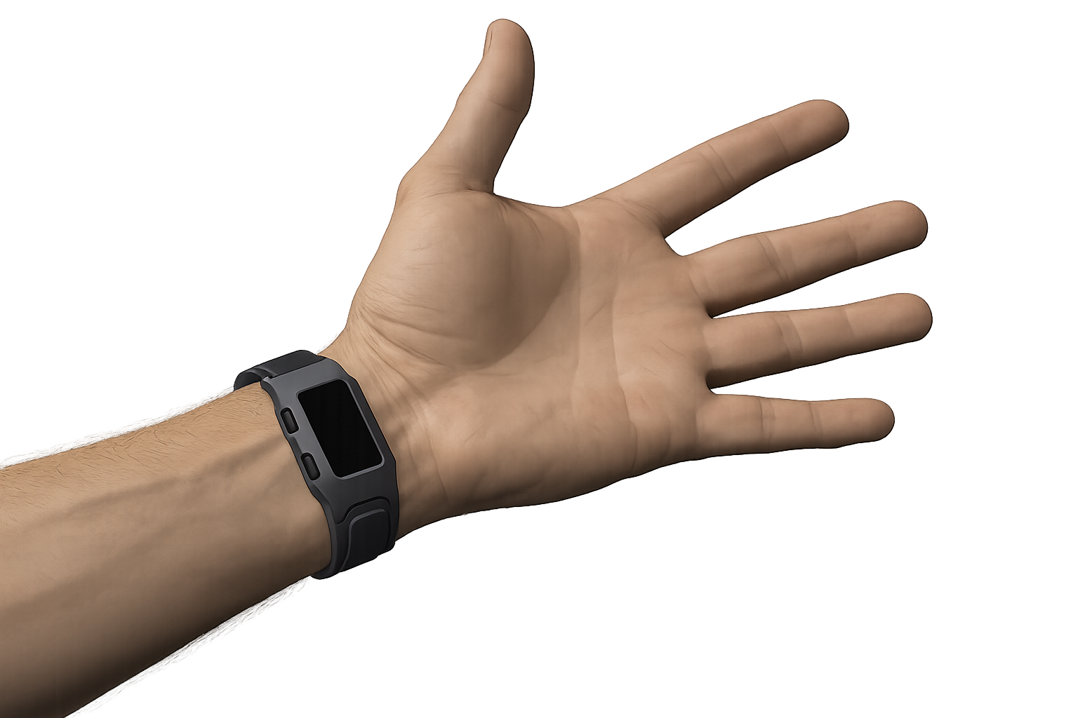
WARTEK
THE INSIGHT
Operators wear their watches on the inside of their wrists.
Across the military, first-responder, and active-enthusiast markets, operators routinely flip their watches to the volar side of the wrist. Quick low-profile glances. No breaking posture. No phone needed. It's a behavior pattern documented across decades.
Volar wrist · WARTEK in operator orientation
Every smartwatch on the market is built for the outside of the wrist.
03 / 19

Slide 4
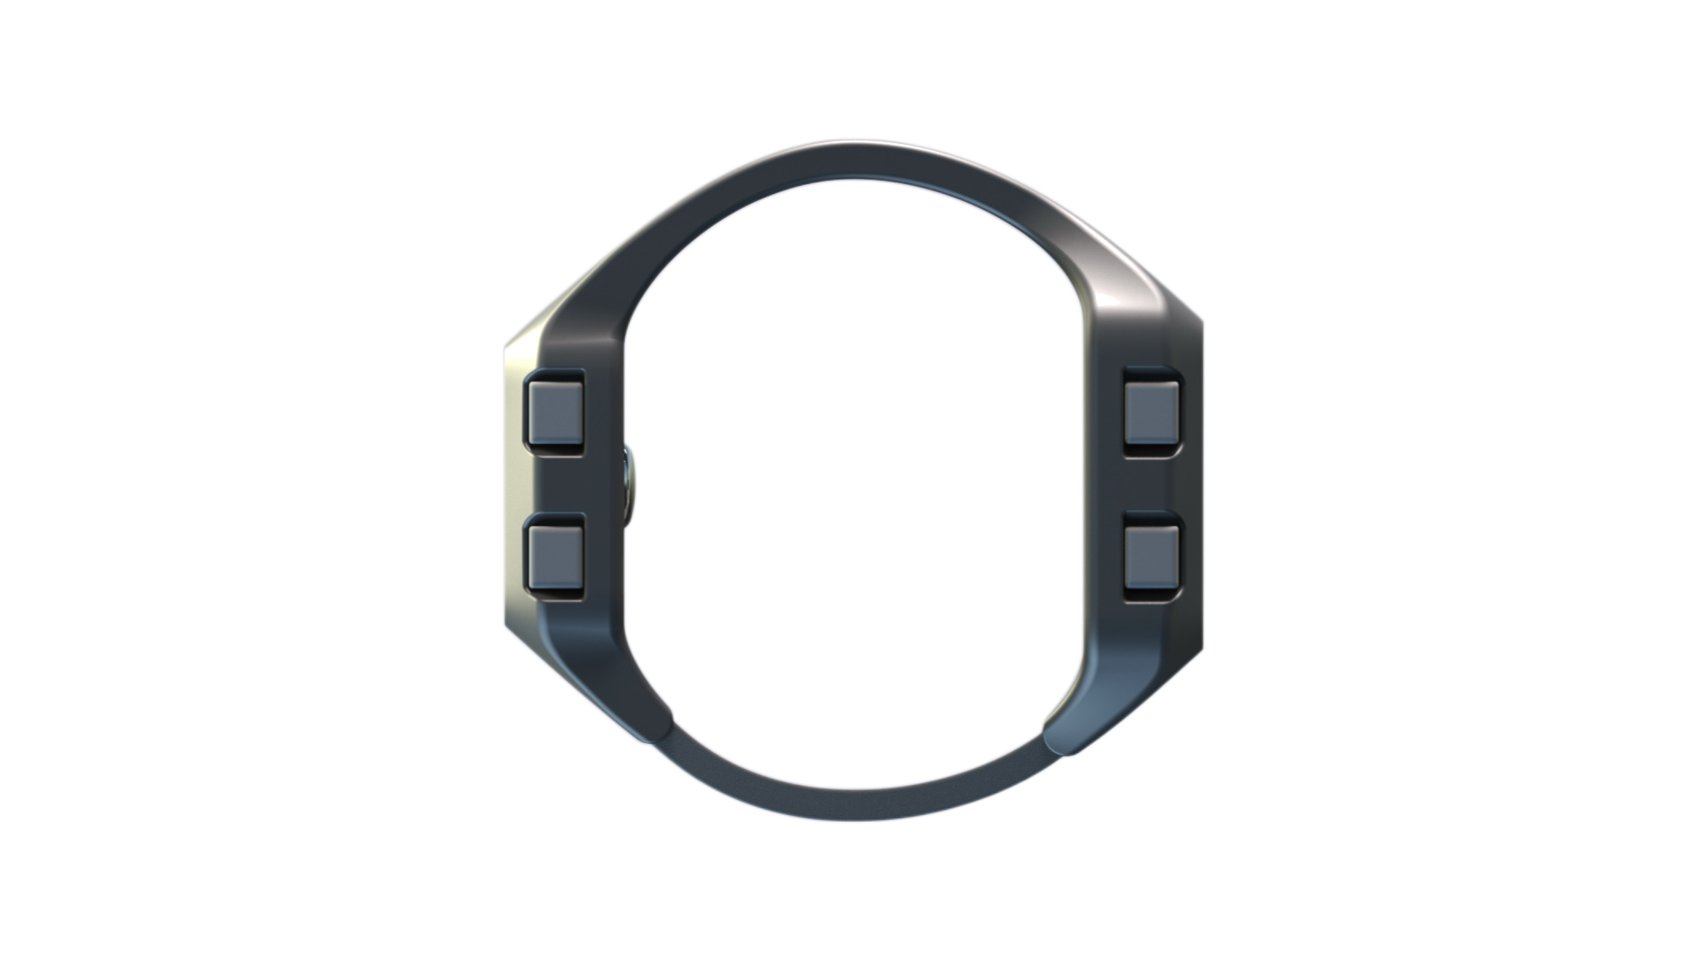
WARTEK
THE SOLUTION
Two displays. One wrist. No interruption.
A patent-protected dual-case architecture: one outward-facing display on the back of the wrist for time and notifications, one inward-facing display on the inside for biometrics, GPS, and the data that has to be in line of sight right now. Connected by a single band. Four oversized corner buttons. Touch on both faces.
DORSAL
VOLAR
BUTTONS
Side profile · 4 corner buttons, both cases visible
33×37 mm
17×32 mm
4 × Corner
Time · Nav · Alerts
Biometrics · GPS
Glove-ready
04 / 19

Slide 5
WARTEK
WHAT IT DOES
Built for the environments where it matters.
DISPLAYS
BIOMETRICS
GPS
MOTION
Touch + tactile hybrid
Volar PPG sensor
Lat · long · elevation
3-axis accelerometer
Two faces. Both touch-capable. Configure per workflow.
HR · HRV · SpO₂ · BP · body temp · continuous.
Time sync, navigation. No phone required.
Movement, orientation, activity tracking.
STEALTH
POWER
WATERPROOF
SHOCK
Red mode + black bg
Replaceable battery
Submersion-rated
Rubberized cases
Preserves night vision. Low-signature.
Rechargeable. Or swap in seconds for multi-day ops.
Sealed seams, gasketed entry. Sweat to dive.
Both cases. Drop, impact, abuse.
05 / 19

Slide 6
WARTEK
INTELLECTUAL PROPERTY
A patented category — not just a product.
U.S. PATENT — GRANTED & ENFORCEABLE
EXAMINER'S STATEMENT OF REASONS FOR ALLOWANCE
“
PATENT NO.
12,625,472 B2
APPLICATION
18/197,777
The prior art does not teach nor suggest the limitations of previous claim 7 now incorporated into claim 1, in combination with the other limitations of claim 1.
FILED
May 16, 2023
GRANTED
May 12, 2026
INVENTOR
Jaylan Mobley
EXAMINER
Sean Kayes · Art Unit 2844
CLAIMS
18 (granted)
TERM
Through 2044
— U.S. Patent and Trademark Office
The federal government's own examiner — after a full prior-art search — confirmed there is nothing else like this in existence. That is the legal definition of "world's first."
06 / 19

Slide 7
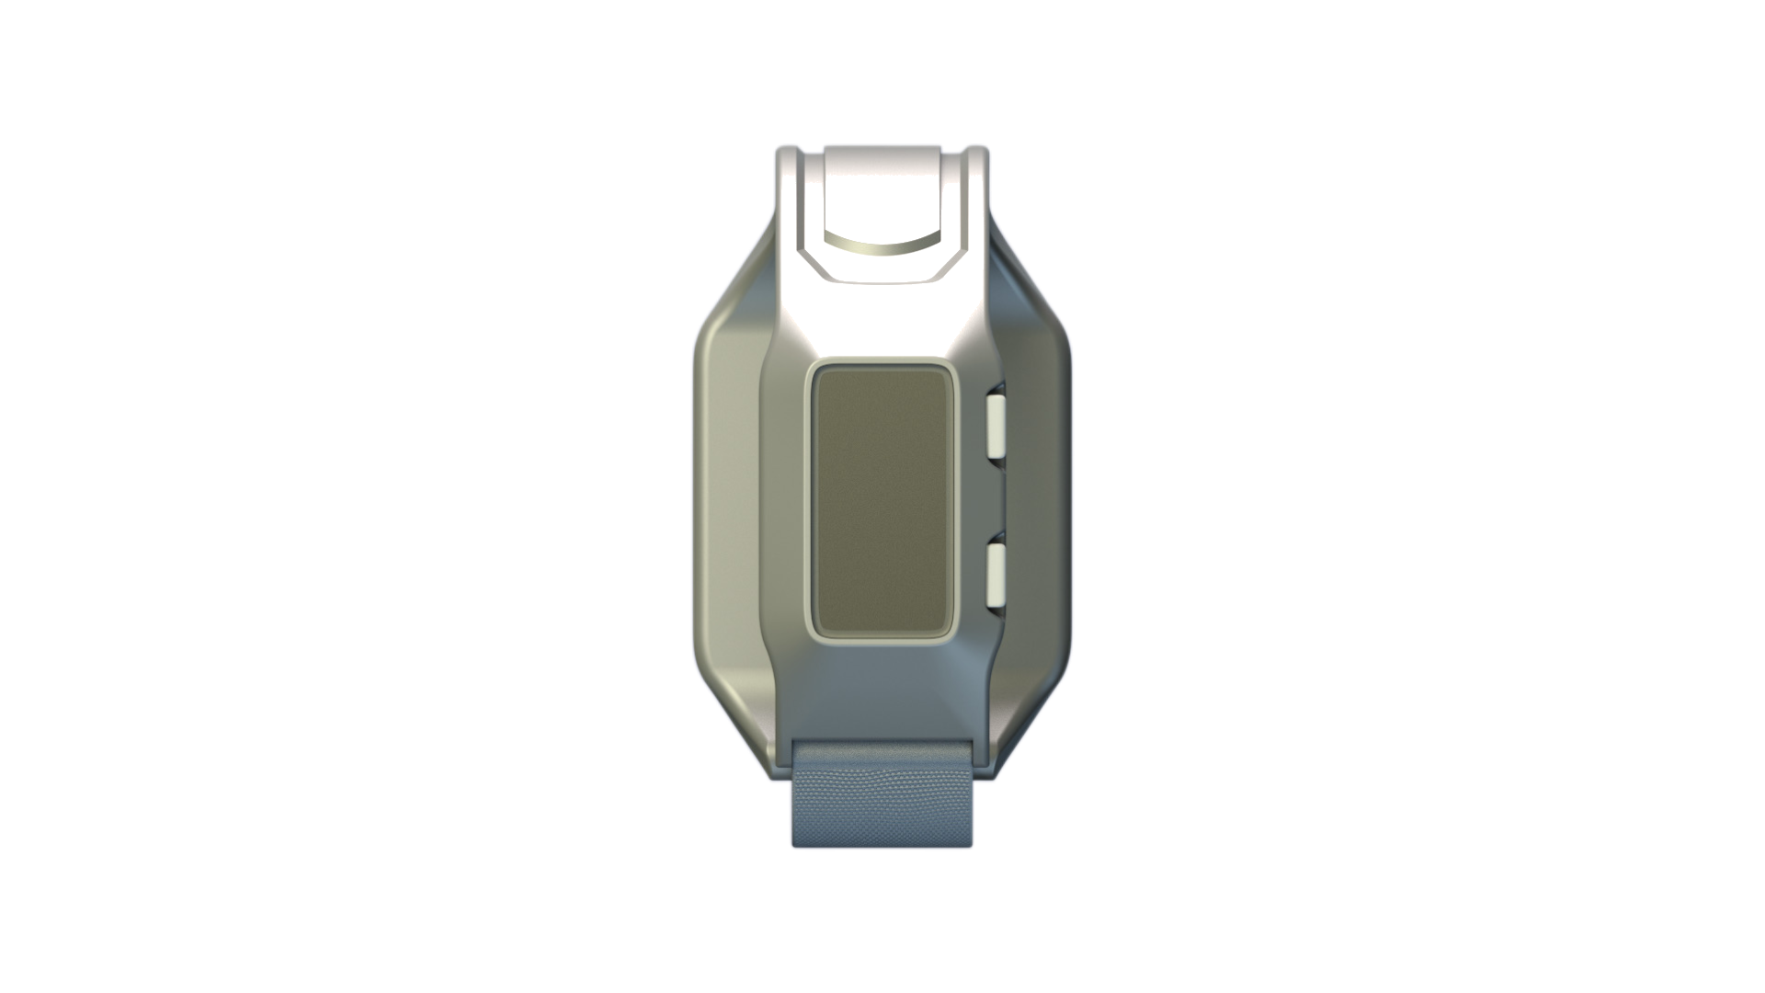
WARTEK
WHERE IT COUNTS
Reading biometrics from the side they're actually visible on.
Every consumer wearable measures the same way — light shined through skin, blood-pulse signal read by a photosensor. The science is sound. The placement is a compromise.
WARTEK's dual-case architecture removes the compromise. The biometric sensor sits against the volar wrist — thinner skin, higher vascular density, the same anatomy a medic palpates to take a pulse.
Volar biometric contact surface
~20%
Of cardiac patients with unreadable dorsal PPG had readings restored by moving the sensor to the volar wrist.¹
↑ Density
Higher vascular density, thinner skin, and fewer hair follicles than the dorsal side — anatomically superior.²
EMS-std.
The radial pulse — standard pulse-check site in pre-hospital and clinical medicine — runs through the volar wrist.
07 / 19
¹ Schoutens et al., European Heart Journal — Digital Health (2025). ² PLOS Digital Health (2024).

Slide 8
WARTEK
THE ARCHITECTURE
Off-net by default. Connected by choice.
Every WARTEK ships ready to operate completely off-grid. No phone tether. No app required. No cloud account. No telemetry. The watch is the platform — the app and hub are optional.
TIER 1 · ALWAYS ACTIVE
TIER 2 · OPTIONAL
TIER 3 · OPTIONAL
The Watch
The App
The Hub
Standalone operation
Personal analytics & sync
Off-net team monitoring
Fully self-contained from unboxing. Dual displays, biometrics, GPS, navigation, history, configuration — all on the device. No external dependencies. Ever.
Pair for long-term graphs, multi-device sync, deeper trends, or to push data into Strava, Apple Health, or Garmin Connect. Opt in when you want to.
For squad leaders, unit medics, training cadres. Real-time team biometrics without an internet connection. Local encrypted mesh. Never touches the public net.
OFF-NET · NO PHONE · ZERO TELEMETRY
OPT-IN · BLUETOOTH · PRIVATE BY DEFAULT
OFF-NET · ENCRYPTED MESH · TEAM USE
Firmware updates are signed, user-initiated, and air-gappable. Cable, app, or hub — your call. The watch never updates itself.
08 / 19

Slide 9
WARTEK
THE COMPANION APP
Add the app when you want more.
Don't when you don't.
ALPHA TEAM
6 Active
DR
D. Reyes
168
BPM
A live, interactive prototype is already built. Demo-ready today.
Medic
MS
M. Singh
132
BPM
Live biometrics
Comms
HR, HRV, SpO₂, body temp, BP, all streaming from the volar sensor
JM
J. Mobley
72
BPM
Watch configuration
Lead
Set per-face data, input mode, stealth settings — from your phone
TK
T. Kowalski
68
BPM
Squad view
Breach
Team leads & unit medics monitor everyone's vitals on a single screen
Privacy by default
On-device only. No ad networks. Optional opt-in cloud sync.
Squad View · live mockup
09 / 19

Slide 10
WARTEK
WHO IT'S FOR
Anyone whose hands are full — or whose eyes need to stay on what they're doing.
SOF / OPERATORS
FIRST RESPONDERS
HEALTHCARE
Tactical professionals
Fire · EMS · Police
Nurses · Physicians
Tier 1 / Tier 2 units, federal LE, intel community. Off-net by default is mission-critical.
Real-time biometrics for command staff. Squad view for incident commanders.
Long shifts. Continuous vitals. Quiet, low-signature in patient rooms.
TRADESPEOPLE
PERFORMANCE ATHLETES
ACTIVE ENTHUSIASTS
Welders · Plumbers · Electricians
Endurance · Tactical fitness
Hunters · Mountaineers · Sailors
Heat stress monitoring. Rugged. Works with gloves and wet hands.
Volar PPG is the better optical site. Athletes get the cleaner signal.
GPS on-board. Multi-day battery. Works without a phone in your pocket.
One platform. Two SKUs is unnecessary — the watch is tactical out of the box, civilian-friendly with the app.
10 / 19

Slide 11
WARTEK
MARKET & POSITIONING
Two markets. One product. Different distribution paths.
CIVILIAN TRACK
TACTICAL TRACK
Volume play
Margin play
$78B+
$3B+
Global smartwatch market (2025)
Wearable tech in defense by 2028
DTC e-commerce. Operator-style brand, mass-market form. Drives volume, brand recognition, and validation. The Whoop / Oura playbook with a tactical posture.
SOCOM, federal LEO, DHS, allied SOF, private security firms. Multi-year procurement contracts. High margin per unit. Halo-effect on the civilian line.
DTC · RETAIL · BRAND-LED
GOV · PROCUREMENT · ENTERPRISE
Two markets, one patent — both protected, both ready to scale.
11 / 19

Slide 12
WARTEK
COMPETITIVE MOAT
Why this can't be retrofitted by anyone else.
WARTEK
Apple Watch
Garmin Tactix
Whoop
Dual displays
✓
✗
✗
✗
Volar sensor placement
✓
✗
✗
✗
Off-net by default
✓
✗
~
✗
No phone required
✓
✗
~
✗
Squad biometrics view
✓
✗
✗
✗
USPTO patent-granted
✓
—
—
—
Every competitor is architecturally constrained to a single, dorsal display. Their hardware can't accommodate the volar face without giving up the dorsal — and they can't add the dorsal back without infringing the patent.
12 / 19

Slide 13

WARTEK
THE FOUNDER
Built to solve a problem he lived.
Jaylan Mobley
Founder & CEO · Inventor of record (U.S. Patent 12,625,472)
Former U.S. Army officer with ten-plus years in the National Guard. Made history as the first cyber officer commissioned in the West Virginia National Guard. First Faculty Fellow at Marshall University via a partnership between the WV Military Authority and Marshall. Also served as a contractor inside the defense industry.
175K+
Top 3
300M+
13
Social audience
Traackr creator rank, 2025
Views across platforms
Major brand partnerships
Nike · Heineken · Puma · General Mills · Netflix · Universal · WNBA · NFL · Jordan · G7 Foundation
13 / 19

Slide 14



WARTEK
TRACTION & MOMENTUM
What's already done.
PATENT GRANTED
ENGINEERING PARTNER
U.S. No. 12,625,472 · issued May 12, 2026
Kickr Design · prototype hardware development
PRODUCT DESIGN
MANUFACTURING
Industrial design complete · CAD files · 3D renders
Marshall University Advanced Manufacturing Center
WEBSITE LIVE
VALIDATION VECTOR
wartek.co · brand language, partner-facing one-pager
U.S. Special Operations Command (SOCOM) signal validation
COMPANION APP
FOUNDER PLATFORM
Interactive prototype live · demo-ready today
175K+ social audience · launch distribution built-in
PARTNERS & CREDENTIALS
14 / 19

Slide 15
WARTEK
THE ASK
Fund the build.
Raising $250K (seed) to take WARTEK from patent-granted to a first working prototype.
USE OF FUNDS
THE TERMS
Engineering & first prototype
$130K
$5M valuation
Kickr Design
Brand & go-to-market
$50K
Invest any amount — equity is pro-rata to the $5M valuation. Offered via SAFE; full terms under NDA.
launch · content · reach
IP, trademark & entity
$40K
CONTACT
patent upkeep · counsel
Jaylan Mobley · Founder & CEO
Operating runway
$30K
jaylan@wartek.co · wartek.co
tools · ops · contingency
Proposed terms for discussion only, subject to negotiation. This is not an offer to sell securities.
15 / 19

Slide 16
WARTEK
THE OPPORTUNITY
Why the math works.
A category bet protected by a granted patent — priced for a real return.
THE DEAL
ILLUSTRATIVE RETURN AT $5M ENTRY
$250K
Seed target (raising)
EXIT VALUE | $250K BECOMES | RETURN
$30M | $1.5M | 6×
$75M | $3.75M | 15×
$150M | $7.5M | 30×
$5M
Company valuation
5%
Equity if you fund the full round
COMPARABLE WEARABLE COMPANIES
Whoop ~$3.6B · Oura ~$2.5B
16 / 19
Illustrative exit scenarios for discussion only — returns shown gross of future dilution. Not a projection, guarantee, or offer to sell securities.

Slide 17
WARTEK
THE MATH
How your return works.
You enter at a low valuation, so every dollar of exit value works harder. Four steps:
1
Enter at the $5M valuation.
WHAT YOUR CHECK BECOMES AT EXIT
YOUR CHECK | $30M EXIT | $75M EXIT | $150M EXIT
$50K | $300K | $750K | $1.5M
$100K | $600K | $1.5M | $3M
$250K | $1.5M | $3.75M | $7.5M
2
Your stake = your check ÷ $5M.
3
At exit, you receive your stake × the exit value.
4
Your return = that payout ÷ your check.
An acquisition counts as an exit — you receive your ownership % of the sale price. Same entry valuation = same multiple on every check (6× / 15× / 30×).
17 / 19
Illustrative exit scenarios for discussion only — figures shown gross of future dilution. Not a projection, guarantee, or offer to sell securities.

Slide 18
WARTEK
Build the category.
Own it for 20 years.
WARTEK is a patent-granted, off-net-by-default tactical platform — built by a U.S. Army veteran and Top-3 U.S. creator (200M+ views, 20+ brand partnerships), with engineering and manufacturing partners already in place.
CONTACT
Jaylan Mobley
jaylan@wartek.co
The ask:
wartek.co
$250K seed at a $5M valuation — invest any amount for pro-rata equity, via SAFE.
704-726-5681
WARTEK · The world's first dual-display tactical watch · U.S. Patent No. 12,625,472

Slide 19
WARTEK
IMPORTANT DISCLOSURES
The fine print.
Confidential. Provided for discussion only; not to be copied or distributed without WARTEK, Inc.'s consent.
Not an offer. This is not an offer to sell, or a solicitation to buy, any security. Any investment is governed solely by the SAFE and definitive investment agreement, and nothing herein may be relied upon outside those documents.
Forward-looking. Statements about future products, features, timelines, pricing, market size, valuation, returns, or outcomes are illustrative estimates only — not promises, guarantees, or projections — and actual results may differ materially.
Investment risk. Any investment is high-risk, illiquid, and may result in total loss of capital. Securities are offered only to accredited investors under applicable exemptions (e.g., Regulation D). Illustrative returns are shown gross of future dilution.
Intellectual property. All IP (U.S. Patent No. 12,625,472, the WARTEK™ trademark, designs, software, and brand) is owned by WARTEK, Inc. Jaylan Mobley acts solely as Founder & CEO of WARTEK, Inc., not individually.
Patent. The grant does not guarantee validity, enforceability, freedom to operate, non-infringement, or commercial success. Product specifications are targets subject to change.
19 / 19

